Slide 1
Data VISUALIZATION
Syifa Silfiyana S

Slide 2
Your data is only as good as your ability to understand and communicate it, which is why choosing the right visualization is essential.

Slide 3
Contents:
Data Types
Data Relationship
Chart Types and examples

Slide 4



Data Types
1. Numerical
These data have meaning as measurement such as blood pressure, person’s height or they are a count such as how many statistic book that you have, how many teeth a dog has.
1. a. Discrete
Numerical data that has finite number of possible values. Ex: numbers of products in a store.
1. b. Continuous
Data that is measured and has value within a range. Ex: speed of a train.
2. Categorical
Data that represent characteristics or data that can be shorted according a group (category), Ex : gender, types of product sold, material status.

Slide 5




Data Relationship
Nominal Comparison
Comparison of the quantitative value. Ex: types of product that sold.
Time Series
Quantitative values that changes over the time. Ex: Revenue in monthly.
Correlation
Data with two or more variable that may shows a positive or negative correlation to each other. Ex: price of product according to demand of product.
Deviation
Describes how data point relate to each other or how far data given differs from the mean. Ex: mathematic exams result class A vs class B.

Slide 6

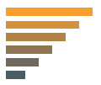

Data Relationship
Distribution
Describe how data distribute around a central value. Ex: weight of people in a area.
Ranking
How two or more variables compare to each other in a dimensions. Ex: sales types of product, ranked from highest to lowest.
Part-to-whole-relationship
Subset data compared to larger whole. Ex: percentage of study course in a university

Slide 7
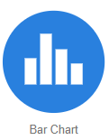
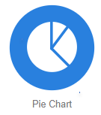
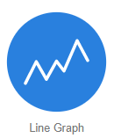
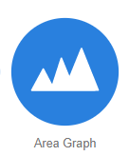
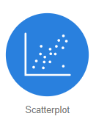
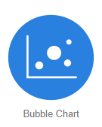
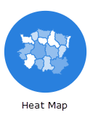
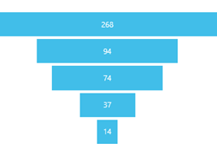
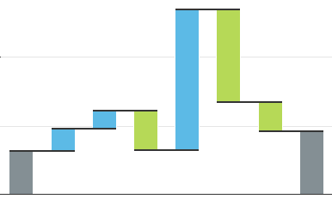
Chart types
Funnel chart
Waterfall chart

Slide 8
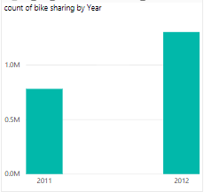
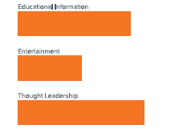
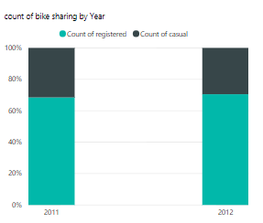
Chart types
a. Bart Chart
used when: - compare different categories, compare part of whole, show changes over time.
Vertical chart Horizontal chart → data with long category label
Stacked or group → when need to compare multiple to whole relationship
Stacked and 100% Stacked

Slide 9
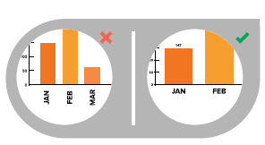
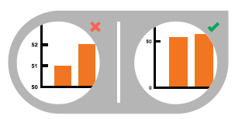
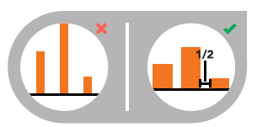
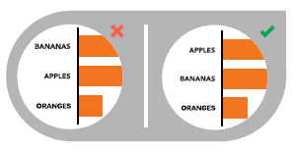
Chart types
Bar Chart _ Best Practices
Horizontal labels Y-AXIS value
Use horizontal label instead of vertical or diagonal labels. Should be start at 0 y-axis, if don’t the reflection of full value will not accurately.
Space bars Order data
Should be ½ width of bar. Order data categories sequentially, alphabetically or by value.

Slide 10
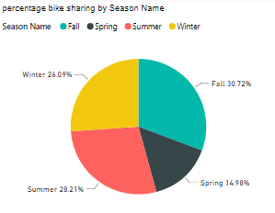
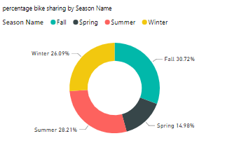
Chart types
b. Pie Chart
Used when : want describes proportion or presentation between categories. Full circle represent the total sum of categories and equal to 100%.

Slide 11
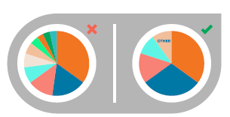
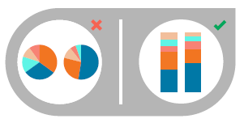
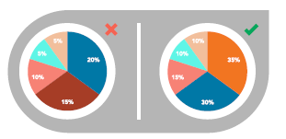
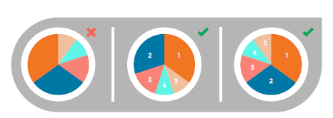
Chart types
Pie Chart _ Best Practices
Multiples Pie Chart
Don’t use multiple pie chart for comparison. Use stacked bar chart instead.
All Data adds up to 100%
Make sure sum total of categories is 100%.
Numbers of categories
No more than 5 categories per pie chart.
Order slice correctly.
The largest slice put at 12 o’clock, going clockwise. Or the second largest slice at 12 o’clock, going counterclockwise.

Slide 12
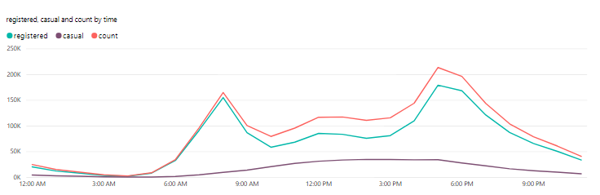
Chart types
c. Line Chart
Used to show the trends and analyze the data has changed over time, also help to show acceleration, deceleration and volatility.

Slide 13
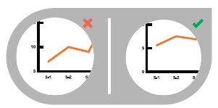
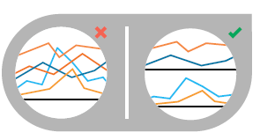
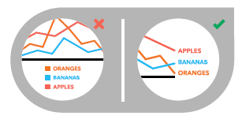
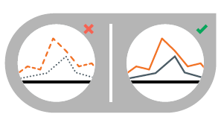
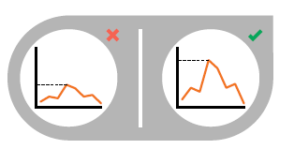
Chart types
Line Chart _ Best Practices
Zero baseline should be included.
No more than 4 lines per line chart.
Label the lines directly.
Use solid line instead of dashed or dotted line.
Use the right height.

Slide 14
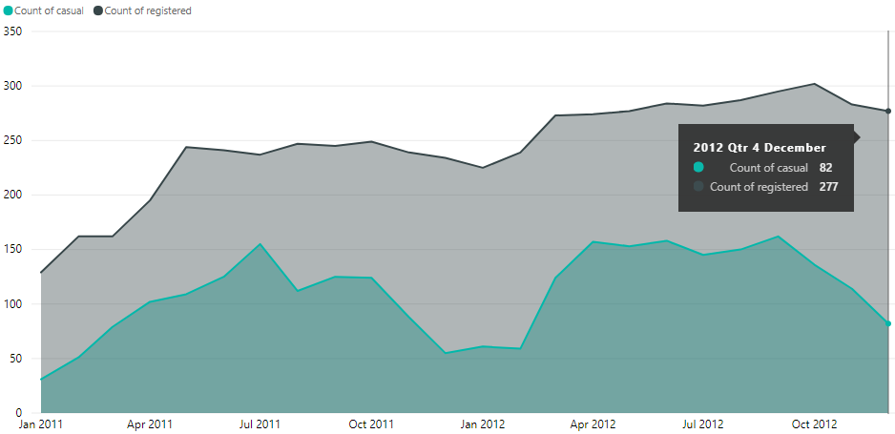
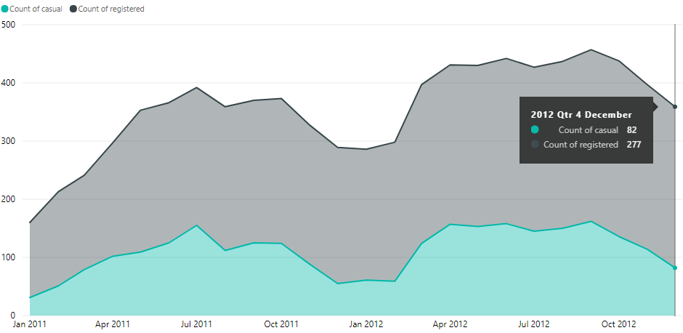
Chart types
d. Area Chart
Use when to display development of quantitative values in a interval or to represent volume in each category. The top value shows sum of total the categories.
Stacked area, best used to help show how each category contribute to cumulative total.

Slide 15
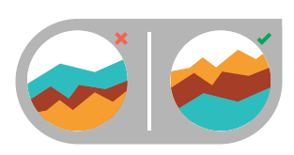
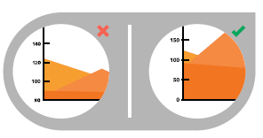
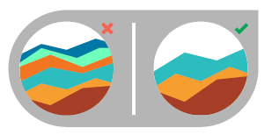
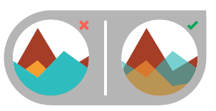
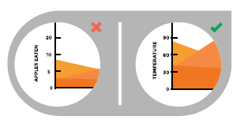
Chart types
Area Chart _ Best Practices
Arrange data position.
Highly variable on the top the chart and low variability on the bottom
Y-AXIS value.
Should be start at 0 y-axis
Numbers of categories.
No more than 4 data categories.
Use transparent colors.
Ensure data isn’t concealed in the background by ordering properly and using transparency.
Not good for discrete data.

Slide 16
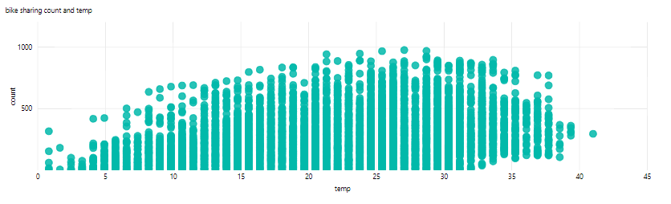
Chart types
e. Scatter Plot
Used to describes relationship or correlation between two variables exists.

Slide 17
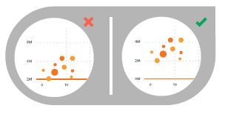
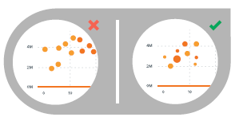
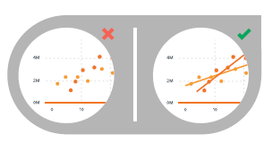
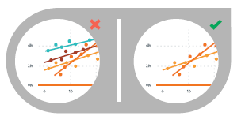
Chart types
e. Scatter Plot _ Best Practices
Y-AXIS value.
Should be start at 0 y-axis
Size and Dot color
Use size and dot color to encode additional data variables.
Trend Line
Use trend line to help draw correlation.
No more than 2 trend lines.
Don’t compare more than 2 trend lines, too many line lines makes difficult to decipher.

Slide 18
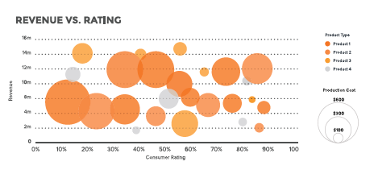
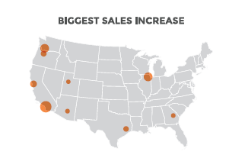
Chart types
f. Bubble Chart
Bubble chart is good for showing comparison or ranking relationship.
By adding bubble chart on the map can shows a visualization value for specific area

Slide 19
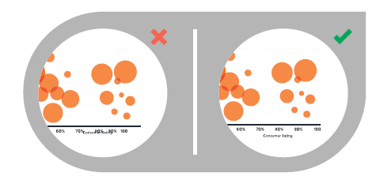
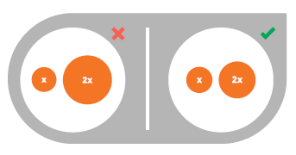
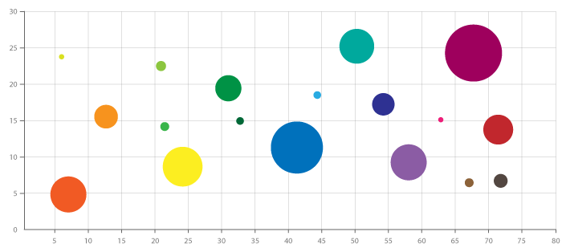
Chart types
Bubble Chart _ Best Practices
Labels are visible
Ensure all labels easily identified and should be unconcealed.
Size of bubble appropriately.
Size of bubbles should be scaled according to area not diameter.
Too many bubbles categories can make the chart hard to read and may look chaotic, show only categories that are important.

Slide 20
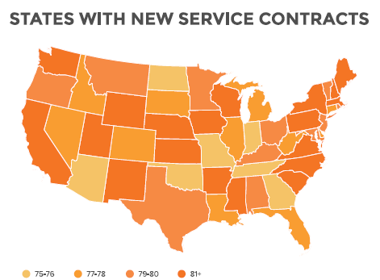
Chart types
g. Heat Map
Heat Map or Choropleth Map used to display categorical data, the data variable uses color intensity to represent itself in each region on the map. Typically can be single hue progression, transparent to opaque, light to dark or entire color spectrum.

Slide 21
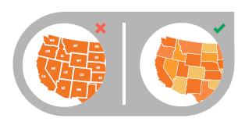
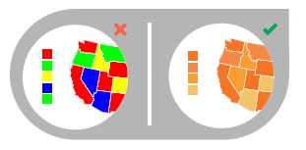
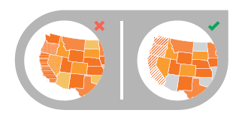

Chart types
Heat Map _ Do & Don’t
Use simple Map Outline
Use outline of the map that easy to read and not distract.
Select color appropriately
Use single color with varying shade to explain intensity.
Select data range appropriately
Choose 3-5 numerical range to show distribution data between them.
Use pattern providently
Using multiple pattern is interfering.

Slide 22

Chart types
h. Funnel Chart
Funnel charts will be a great choice when:
Data is sequential and move through at leas 4 stages.
The number of category in the fist stage is expected to be greater than the number in final stage.
Want to reveal a bottleneck in linear process.
Want compute potential by stages.
Want track the progress and success of the campaign.

Slide 23

Chart types
i. Waterfall Chart
Waterfall charts will be a great choice when:
You have a changes of measurement of different categories across the time
Want to check the major changes contributing to the total value.
Want to plot a company’s annual profit

Slide 24
Sources
https://docs.microsoft.com
https://datavizcatalogue.com
Data_Visualization_101_How_to_Design_Chart_and_Graphs.pdf

Slide 25

Thank you
Syifa Silfiyana S
syifa.silfiyana@gmail.com
https://www.linkedin.com/in/syifa-silfiyana

Slide 26
THANK YOU

